Slide 1
Health inequality monitoring: with a special focus on low- and middle-income countries
Lecture 3: Data sources

Slide 2
Data collection infrastructure
Ideally, data should come from an information-producing system that:
  has strong legitimacy
  has high-level political support
  is transparent
  includes policy, technical, academic and civil society constituencies
<number> |
Handbook on Health Inequality Monitoring
Notes:
Describing the state of health inequality in a population requires valid and reliable data, which are acceptable for use from a ethical and cultural standpoints.
The infrastructure that collects and organizes data is important to consider, as its strength will affect the merit of the data.
Sometimes health information infrastructure is created with the express purpose of collecting data for health monitoring, as is the case with large household health surveys.
Other times, data that are used for health monitoring are created for other purposes originally, but can also be applied for use in health monitoring.

Slide 3
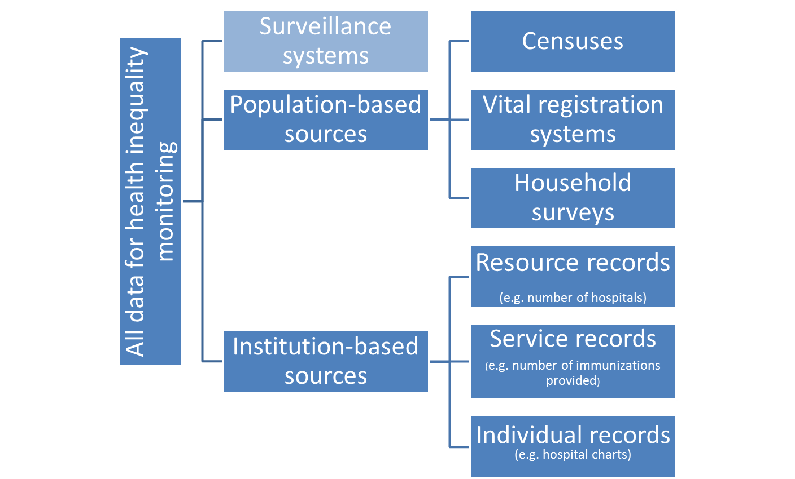
Data source types
<number> |
Handbook on Health Inequality Monitoring
Notes:
There are essentially two broad categories of data sources: (a) population based; and (b) institution based. Surveillance systems, which combine population-based and institution-based data, are sometimes classified as a third category.
Population-based data sources include sources that have information on every individual in a population (for example, censuses or vital registration systems) and sources that have information on a representative sample of the population (for example, household surveys).
Institution-based data sources gather data in the course of administrative and operational activities, and thus only include people that have had interaction with a given institution. It is possible that administrative data from institution-based sources could reflect the individual or household level (for example, waiting time to elective surgeries or surgical wound infection rate), or at the national or subnational level (for example, general service readiness or total health expenditure per capita). Examples of institution-based data sources include resource, service or individual records.

Slide 4
Population-based sources: censuses
National population and household censuses are implemented every 10 years in most countries
Data cover the entire population (or nearly so), providing accurate denominator counts for population subgroups
Censuses may be a good source of information about equity stratifiers, but usually contain only limited information on health
Possible improvements:
  include individual or small-area identifiers
  include mortality and cause of death questions
<number> |
Handbook on Health Inequality Monitoring
Notes:
In many countries, the census provides information on sex, socioeconomic status, race or ethnicity, age and geographical area, all of which can be used as equity stratifiers for inequality monitoring. This type of information is essential to ensure that survey data are representative of the entire population.
The census is not usually health focused, and typically includes few health data. As a result, censuses may have limited utility for health inequality monitoring unless there is a means to link census data to other sources of health information.
For example, an individual’s social security number could be used to link data from two different sources.
Linkages often exist in high-income countries, but not in many low- and middle-income countries.
An improvement that could be made to censuses in low- and middle-income countries would be to include small-area identifiers, such as postal codes, to link with data from other sources.
While individual-level identifiers would be ideal for providing such data linkages, small-area identifiers, if standardized across different data sources, may be more-easily implemented.
Censuses could be strengthened by collecting high-quality data about mortality and cause of death. Including this type of information in censuses is particularly useful in countries where it is not reliably available from other information systems.

Slide 5
Population-based sources: vital registration systems
For example, national birth or death registries
These systems are the best and most-reliable source for fertility, mortality, life expectancy and cause-of-death statistics
Vital registration systems can often be linked to information on sex, geographical region, occupation, education
Incomplete in many low- and middle-income countries
Possible improvements:
  Expand coverage
  Include cause of death, birth weight and gestational age
  Include at least one socioeconomic indicator
<number> |
Handbook on Health Inequality Monitoring
Notes:
Vital registration systems (officially called civil registration and vital statistics systems) record the occurrence of births, deaths, marriages and divorces in a population.
Countries that have strong vital registration systems can reliably determine and track mortality rates, life expectancies and cause-of-death at a population level.
Additionally, vital registration systems often provide necessary data about equity stratifiers that is useful for inequality monitoring.
Expanding the coverage of existing vital registration systems is the single most important change that could improve the utility of vital registration systems for health inequality monitoring.

Slide 6
Global status of vital registration systems
EXTRA INFORMATION
In 2009…
  only 25% of the world population lived in countries where at least 90% of births and deaths are registered
  only 34 countries (representing 15% of the global population) had high-quality cause-of-death data
  74 countries lacked data altogether about births and deaths
  In the WHO African Region 42 out of 46 countries had no death registration data
Source: World Health Organization. World Health Statistics 2012. Geneva, World Health Organization, 2012.
<number> |
Handbook on Health Inequality Monitoring

Slide 7
Population-based sources: household surveys
Currently the most common and overall most reliable data source for health inequality monitoring in low- and middle-income countries
Data are representative for a specific population (often national)
Have rich data on a specific health topic as well as living standards and other complementary variables
Often repeated over time, allowing for measurement of time trends
Conducted in multiple countries, allowing for benchmarking
Sampling and non-sampling errors can be important
Survey may not be representative of small subpopulations of interest
Possible improvements:
  Repeat surveys on a regular basis
  Enhance comparability over time and between countries by harmonizing survey questions
  Increase sample sizes
<number> |
Handbook on Health Inequality Monitoring
Notes:
Household surveys are conducted with the purpose of evaluating the status of a specific topic (or topics) at a national level, and may be administered by countries, aid organizations, nongovernmental organizations or international organizations.
Usually, household surveys cover a large number of indicators, all related to a similar theme, such as reproductive, maternal and child health, or nutrition.
Household surveys often provide specific information on health topics of interest in low- and middle-income countries, in conjunction with both individual-level and household-level socioeconomic, demographic and geographical information.
While several low- and middle-income countries conduct their own household surveys, there are also an increasing number of multinational, multi-round household survey programmes. The repeated rounds of these multinational surveys allow for the tracking of progress in inequalities over time; the inclusion of multiple countries allows for benchmarking between countries using comparable data methodologies.
By design, household surveys draw information from a sample of the population rather than each individual within the population. While household surveys are generally designed to have sufficient sample size to draw precise conclusions about the overall population, they are not necessarily designed with the purpose of having sufficient sample sizes in all subgroups. If it is anticipated that the survey will have a low sample size in a certain subgroup, the design may compensate by oversampling. This may involve drawing larger samples from certain minority groups, regions, education levels, age groups or other categories, though these subgroups may represent a relatively small proportion of the overall population.

Slide 8
Examples of multinational household survey programmes
EXTRA INFORMATION
Survey name | Organization | Website
AIDS Indicator Survey (AIS) | United States Agency for International Development | http://www.measuredhs.com/What-We-Do/Survey-Types/AIS.cfm
Demographic and Health Survey (DHS) | United States Agency for International Development | http://www.measuredhs.com/
Living Standards Measurement Study (LSMS) | World Bank | http://go.worldbank.org/IPLXWMCNJ0
Malaria Indicator Survey (MIS) | United States Agency for International Development | http://www.malariasurveys.org/
Multiple Indicator Cluster Survey (MICS) | United Nations Children’s Fund | http://www.unicef.org/statistics/index_24302.html
Study on Global Ageing and Adult Health (SAGE) | World Health Organization | http://www.who.int/healthinfo/systems/sage/en/
World Health Survey (WHS) | World Health Organization | http://www.who.int/healthinfo/survey/en/index.html
<number> |
Handbook on Health Inequality Monitoring

Slide 9
Data availability in low- and middle-income countries
EXTRA INFORMATION
Household surveys are the main data source in many low- and middle-income countries
Health inequality monitoring in low- and middle-income countries is limited to the health indicators for which data are available
  Often outcome or impact indicators
Certain health topics may be challenging to monitor, particularly those related to inputs and processes and outputs, which are usually collected from institution-based sources
<number> |
Handbook on Health Inequality Monitoring
Notes:
Because of the large reliance on household survey data, health inequality monitoring in low- and middle-income countries is limited to the health indicators for which data are available.
Often there is a focus on two components of the monitoring, evaluation and review framework: the outcomes component (for example, coverage of health interventions) and the impact component (with an emphasis on health status indicators, such as mortality and morbidity).
Because health indicators related to inputs and processes, and outputs are generally collected from institution-based sources, the inclusion of these indicators in health inequality monitoring in low- and middle-income countries is uncommon.
There are occasionally studies in low- and middle-income countries that are specifically dedicated to cover these often-neglected topics.

Slide 10
Institution-based data sources
Data are readily and quickly available
Can be used at lower administrative levels (e.g. district level)
Data may be fragmented or of poor quality
Often data cannot be linked to other sources
Data may not be representative of the whole population
Possible improvements:
  Include individual or small-area identifiers
  Standardize electronic records across institutions
<number> |
Handbook on Health Inequality Monitoring
Notes:
Institution-based data sources produce administrative data in the course of government and health system activities.
Examples include institutional records for individuals, such as medical charts, police records, employment records and school records.
Institution-based data also encompass internally-kept records describing the activities of institutions, such as health facility resource records that contain district-level information about the personnel deployed in a given region, or the records of services delivered (for example, number of vaccines given or number of bed nets distributed). These data sources tend to be numerous, and provide detailed data at the community level.
Data from institution-based sources may reflect any component of the monitoring, evaluation and review framework; health indicators that are listed in the inputs and processes component are often derived from institution-based data sources.
Administrative data only capture information on individuals who interact with a given institution.
For example, health centre records cannot provide any information on those who do not access the health centre. In health inequality monitoring, however, populations with limited institutional access are often of high interest.
At the country level, the use of administrative data is limited by its lack of standardization and fragmentation. Thus, institution-based data sources tend to be of lesser importance for health inequality monitoring at a national level, especially in low- and middle-income countries.
However, it should be noted that administrative data could be useful for inequality monitoring in low- and middle-income countries at lower administrative levels (such as a district level), as they provide a high level of detail that may not exist in other data sources; at the local level, administrative data may be the only data available.

Slide 11
Surveillance systems
Can provide detailed data on a single condition or from selected sites
Data may be useful for correction of over- or under-reporting
Not always representative of population
Some systems may collect little information relevant to equity stratifiers
Possible improvements:
  Include individual or small-area identifiers
  Integrate surveillance functionality into larger health information systems with full coverage
<number> |
Handbook on Health Inequality Monitoring

Slide 12
Types of surveillance systems
EXTRA INFORMATION
Outbreak disease surveillance
  aims to track cases of epidemic-prone diseases as well as their risk factors
  often relies on frequent reporting by health facilities, such as laboratories
Sentinel surveillance
  uses a sample of clinics for intensified monitoring
  is used by disease programmes such as HIV and malaria
Risk factor surveillance
  describes data collection and analysis in noncommunicable disease monitoring
  often focuses on data obtained through surveys
Demographic surveillance
  found in many low- and middle-income countries
  sites have a longitudinal birth and death registration system for a local population to collect information about cause of death and other health-related data
<number> |
Handbook on Health Inequality Monitoring

Slide 13
Data source mapping
Involves cataloguing and describing all data sources available for a given country, province, district or other administrative unit to determine which sources can be used for health inequality monitoring
Can also identify important gaps that indicate where a country lacks data about health indicators or equity stratifiers
Consists of four steps
<number> |
Handbook on Health Inequality Monitoring
Notes:
Ideally, the selection of health indicators occurs simultaneously with an inventory of available data. Clearly, it is not possible to conduct health inequality monitoring for indicators where no data exist!
Data source mapping can be broken down into four steps, each building on the previous.
Note that these four steps provide only one approach to data source mapping for health inequality monitoring; however, the method shown here is not the only way to conduct this exercise. Any of the following steps may be modified to suit the needs of the users.

Slide 14
Data source mapping: step 1
List of data sources by type (partial table)
Data source type | Data source | Year(s) of data collection | Notes
Census | National census | 1990, 2000, 2010
Administrative | Immunization records | 2000–2006 | Annual collection
Household survey | Standard DHS | 1994, 1999, 2004, 2009
…
Note: DHS = Demographic and Health Survey
<number> |
Handbook on Health Inequality Monitoring
Notes:
The process of data source mapping begins by creating a list of available data by source type (census, administrative, household survey, etc.), data source name, and year(s) of data collection.
A Notes column may be added for relevant comments, such as the frequency of data collection.

Slide 15
Data source mapping: step 2
List of data sources and equity stratifiers (partial table)
No. | Data source and year | Equity stratifier |  |  |  | Notes
 |  | Sex | Wealth | Place of residence | Province or region
1 | Immunization records 2000–2006 |  |  |  | √
2 | DHS 2009 | √ | √ | √ | √ | 17 provinces
3 | DHS 2004 | √ |  | √ | √ | 13 provinces
 | …
<number> |
Handbook on Health Inequality Monitoring
Notes:
If one database does not contain information about a particular equity stratifier, it may sometimes be linked to other databases that do contain this information. In order to identify possible linkages, it is necessary to first make a list of every existing data source that provides information on each equity stratifier.
The expanded list shown here includes the availability of equity stratifiers within these data sources. A check mark (√) indicates that the equity stratifier data are contained within the data source.
In creating this list, it is important to recognize that different data may be available in different years for a given data source.
For example, here the DHS household health survey conducted in 2004 did not have information on household wealth, whereas the household health survey conducted in 2009 did contain this information.
For this reason, a table may be created with an expanded list of data sources by year.
For easy reference in the next steps, each row is numbered.
A Notes column may be added for relevant comments or additional information, such as how equity stratifiers are grouped.

Slide 16
Data source mapping: step 3
List of health topics and corresponding data sources (partial table)
Health topic | Data source number
Child health | 1 | 2 | 3 | …
Maternal health | 2 | 3 | …
…
<number> |
Handbook on Health Inequality Monitoring
Notes:
The next step is to create a list of priority health topics and indicate whether they are described within the various data sources.
Alongside each health topic, the data source number (as indicated in step 2) can be listed to show the data sources that contain data on that topic.

Slide 17
Data source mapping: step 4
Data source map (partial table)
Health topic | Equity stratifier
 | Sex | Wealth | Place of residence | Province or region
Child health | 2, 3 … | 2 … | 2, 3 … | 1, 2, 3 …
Maternal health | Not applicable | 2 … | 2, 3 … | 2, 3 …
…
<number> |
Handbook on Health Inequality Monitoring
Notes:
The list of health topics within unique data sources (from step 3) should be the starting point for this map.
From this point, each unique data source on a given health topic and its association with equity stratifiers should be considered.
To create the map, data sources with information on each health topic should be listed by their connection to the equity stratifier information, in a single table. A partial data source map is shown.
Note that the numbers refer to the unique data sources, as introduced in step 2.
Using a data source map enables the selection of health indicators with available data for health inequality monitoring. Once data have been sourced and obtained, the next step of the health inequality monitoring cycle is to measure health inequality.

Slide 18
Overcoming data unavailability
TIP
If a country wishes to monitor a priority health topic or indicator for which there are currently no data available, immediate analysis is not possible
  Advocating for the collection of additional data may enable analysis and monitoring in the future
Strengthening, modifying or expanding existing data sources may be feasible options to generate new information
<number> |
Handbook on Health Inequality Monitoring

Slide 19

Health inequality monitoring: with a special focus on low- and middle-income countries
Full text available online: http://apps.who.int/iris/bitstream/10665/85345/1/9789241548632_eng.pdf

